Slide 1
Project 2: Indian Agriculture analysis using power bi

Slide 2
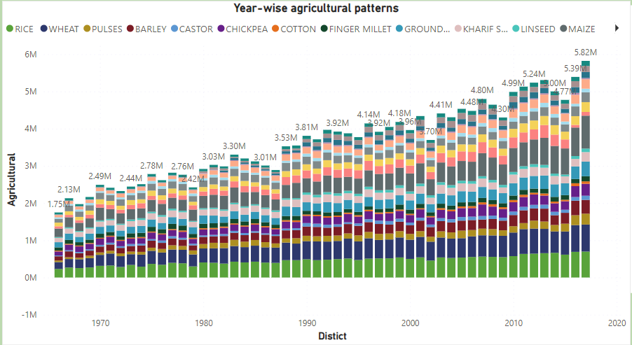
Interactive Power BI dashboards providing insights into year-wise agricultural patterns.
At 6,97,413.68 in 2017 had the highest RICE and was 202.10% higher than 1966, which had the lowest RICE at 2,30,856.94.RICE and total WHEAT are positively correlated with each other.﻿﻿ ﻿﻿ ﻿﻿2017 accounted for 2.90% of RICE. ﻿﻿Across all 52 Year, RICE ranged from 2,30,856.94 to 6,97,413.68, WHEAT ranged from 1,84,518.02 to 7,26,132.97, and PULSES ranged from 41,342.77 to 2,92,217.61.﻿﻿ ﻿

Slide 3
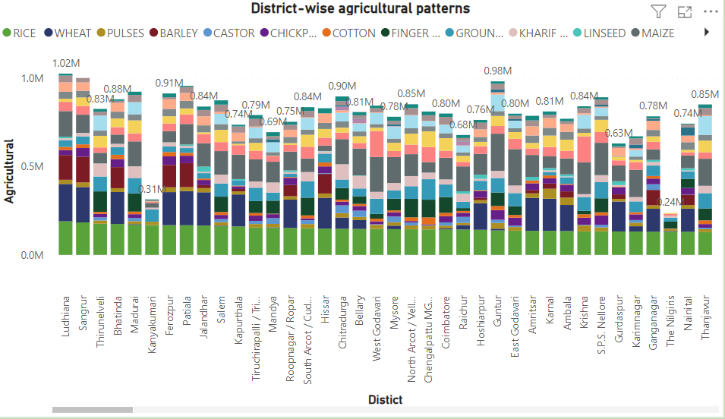
Interactive Power BI dashboards providing insights into district-wise agricultural patterns.
﻿At 1,89,822.57, Ludhiana had the highest RICE and was 94,91,228.50% higher than Lahul & Spiti, which had the lowest RICE at-2. ﻿﻿RICE and total WHEAT are negatively correlated with each other.﻿﻿ ﻿﻿ ﻿﻿Ludhiana accounted for 0.79% of RICE .﻿﻿ ﻿﻿ ﻿﻿Across all 311 Dist Name, RICE ranged from -2 to 1,89,822.57, WHEAT ranged from 0 to 2,11,092.97, and PULSES ranged from 0 to 1,04,497.01.﻿﻿ ﻿

Slide 4
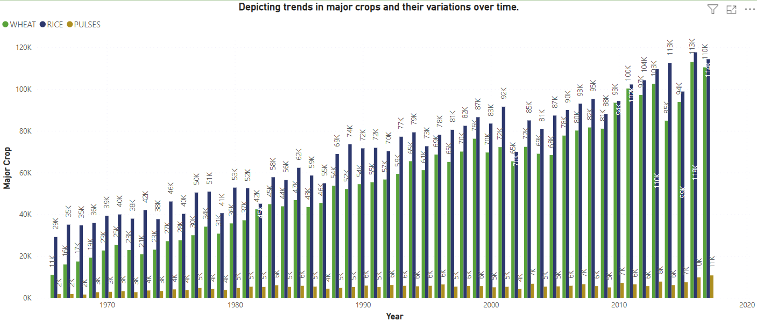
Visualizations depicting trends in major crops and their variations over time.
﻿At 1,12,962.82 in 2016 had the highest WHEAT and was 927.95% higher than 1966, which had the lowest WHEAT at 10,989.12.﻿﻿ ﻿﻿ ﻿﻿WHEAT and total RICE are positively correlated with each other.﻿﻿ ﻿﻿ ﻿﻿2016 accounted for 3.84% of WHEAT.﻿﻿ ﻿﻿ ﻿﻿Across all 52 Year, WHEAT ranged from 10,989.12 to 1,12,962.82, RICE ranged from 29,133.23 to 1,17,614.10, and PULSES ranged from 1,571.99 to 10,750.14.﻿﻿ ﻿

Slide 5


